Slide 1
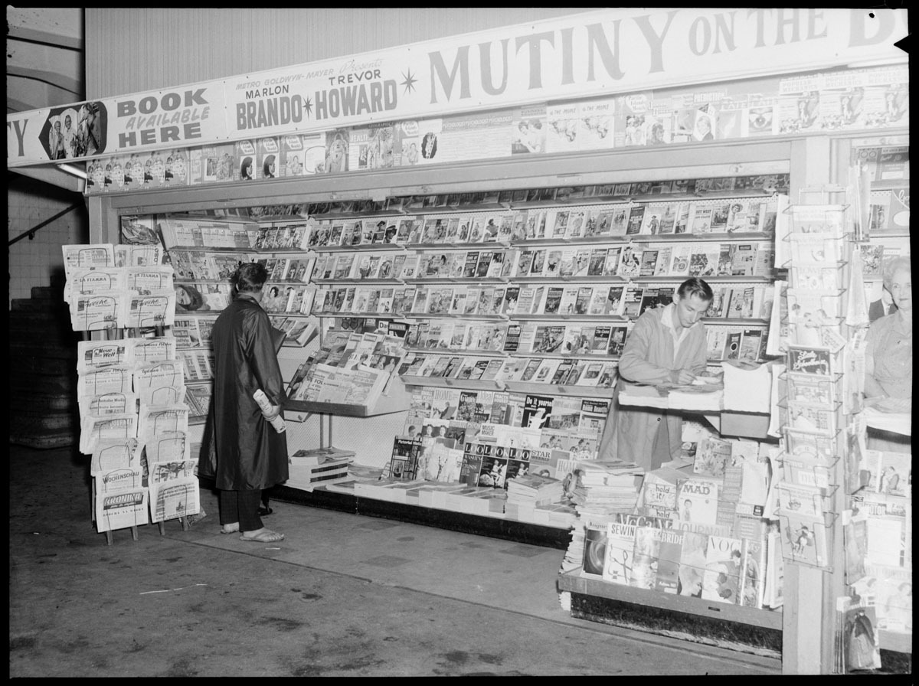













Headline Satire Detector
ABOUT:
Classifying news articles through headline analysis using NLP and deep learning methods
TOOLS:
TIMELINE:
5 weeks
/gabrielatanumihardja
/gabrielaeaton

Slide 2
All Generalizations are Wrong, Including This One…
Satire & Natural Language Processing:
Can ML models detect the subtle nuances?
Satire can be difficult to differentiate by headlines

Slide 3
Can You Tell?
Sample headlines:
The Lamp Was a Clue to a Life I Didn’t Know My Mother Had
DNC Pours All Campaign Funding Into New York, California To Win Popular Vote By Even Greater Margin Than 2016

Slide 4


Can You Tell?
Sample headlines:
The Lamp Was a Clue to a Life I Didn’t Know My Mother Had
DNC Pours All Campaign Funding Into New York, California To Win Popular Vote By Even Greater Margin Than 2016
SATIRE

Slide 5




Project Framework
1
Data acquisition and cleaning
Scrape headlines from four online news sources
2
Train baseline models and evaluate
Logit, SVM, Naïve Bayes, KNN, Random Forest
Adjust data
3
Resample by year and sources
Train advanced models and deep learning models
4
AdaBoost, XGBoost, BERT model

Slide 6
Results + Predicting Sources
Validation accuracies ranging from 63% - 90%
BERT model - 90% validation accuracy
Predicting source of article:
BERT model - 80% validation accuracy
The Beaverton headlines often misclassified as belonging to the Onion (20%)

Slide 7
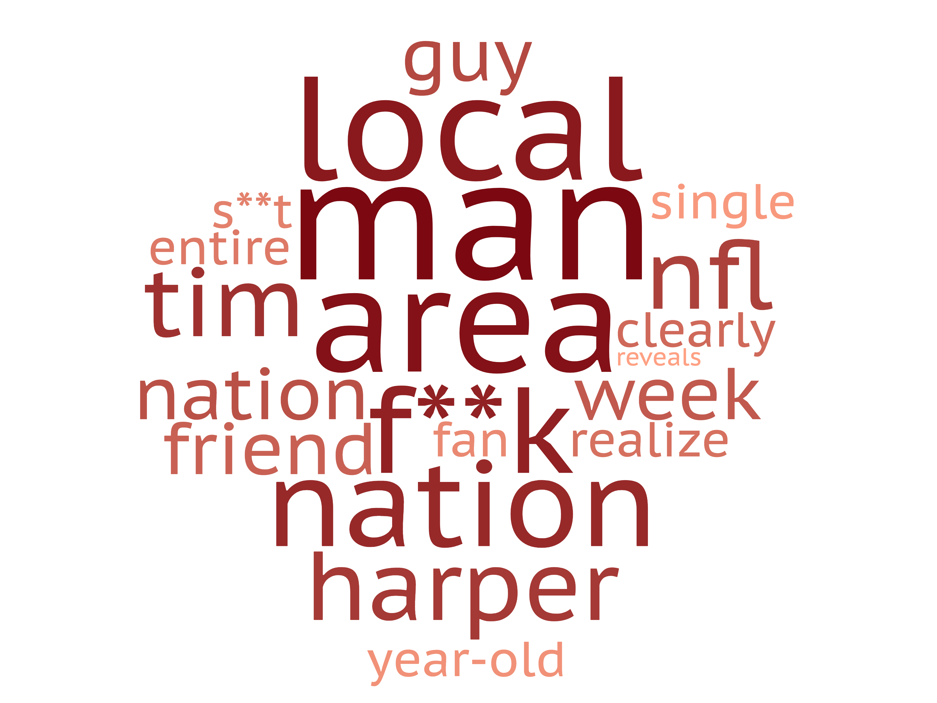
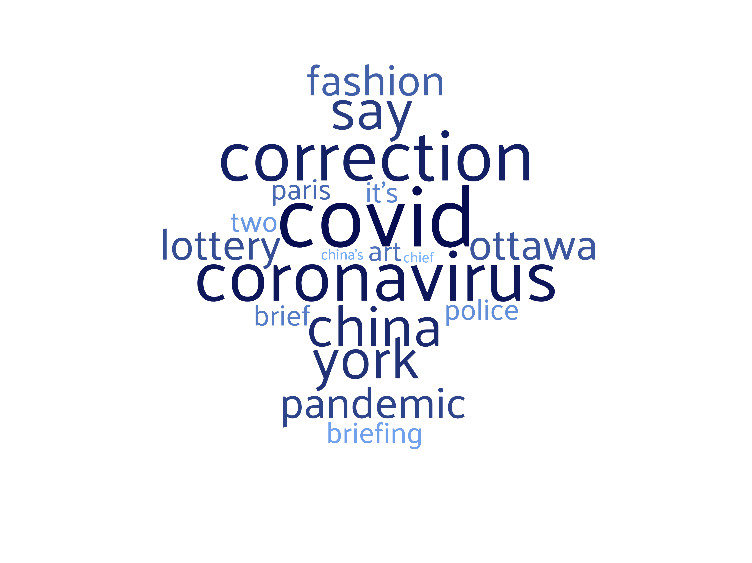
Predictive Words
Satire
Legitimate

Slide 8
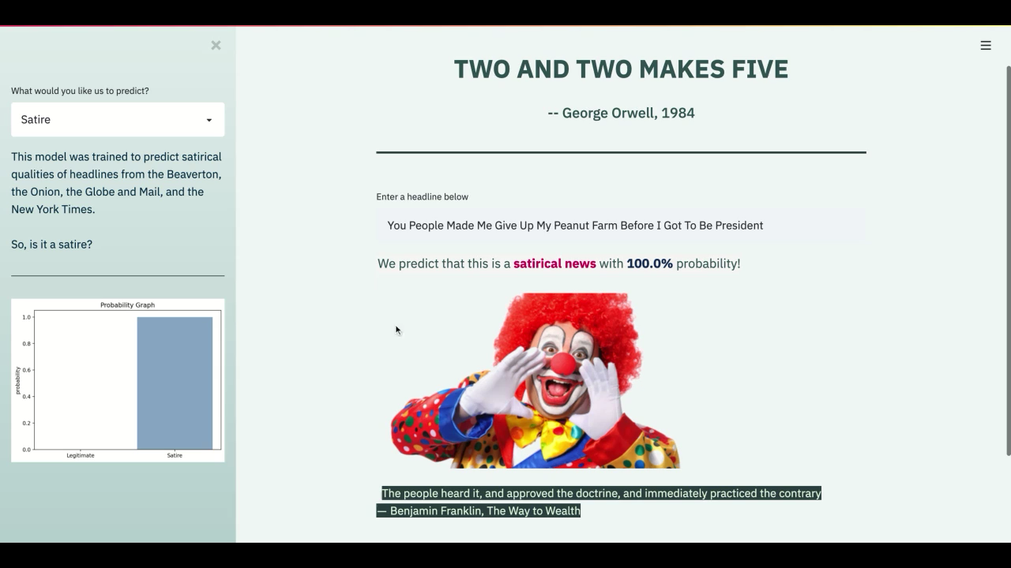
Serve Up! What’s Next?

Slide 9
Thank you!
linkedin.com/in/gabrielatanumihardja/
github.com/gabrielaeaton

